Slide 1
Data Visualization 2
Introduction to Data Visualization with Python
2023 Fall - Session 2

Slide 2
Personal project

Slide 3
Grading
After the last session, every student will create a data visualization project in Python
The project consists of a Jupyter notebook
Code, charts and documentation in one place
Please use only Plotly Express and Dash for the charts and dashboards
The tasks typically include
Selecting a dataset
Create nice charts (at last one needed, you can also create two).
Create a Dash App using the charts, text components and controls
Format the chart(s) accorcing to the dataviz best practices
Make sure that the interactivity works as expected

Slide 4
Selecting a dataset
A good dataset will have
A few categorical variables used in charts and/or for filtering
A few numerical variables
A date variable for trend charts
Suggestion: the Maven Analytics Playground
It has a number of good quality datasets
Filter for datasets where
Data Structure: Single Table
Access Type: Free

Slide 5
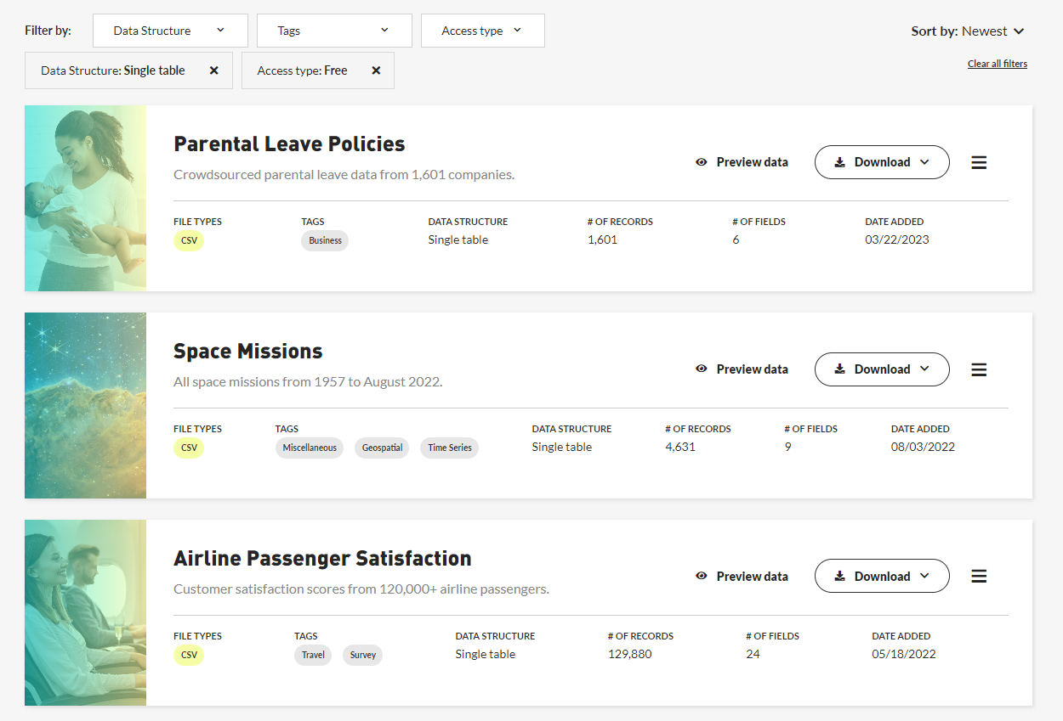
Maven Analytics Playground
https://www.mavenanalytics.io/data-playground

Slide 6
Working with your dataset
The recommended way is to use Github to host your data file and load it from there in your notebook
You can use our Github repo
It contains a few Maven Analytics datasets you can directly load
Links are listed on the Datasets worksheet of the Admin workbook in the Github URL column
Use the link to access the dataset from the notebook - pd.read_csv( link)
You can also use your own repo with any dataset
Upload your dataset to your public Github repo
Navigate to your dataset and use the Raw button the get the link to the file
Use the link to access the dataset from the notebook - pd.read_csv( link)

Slide 7
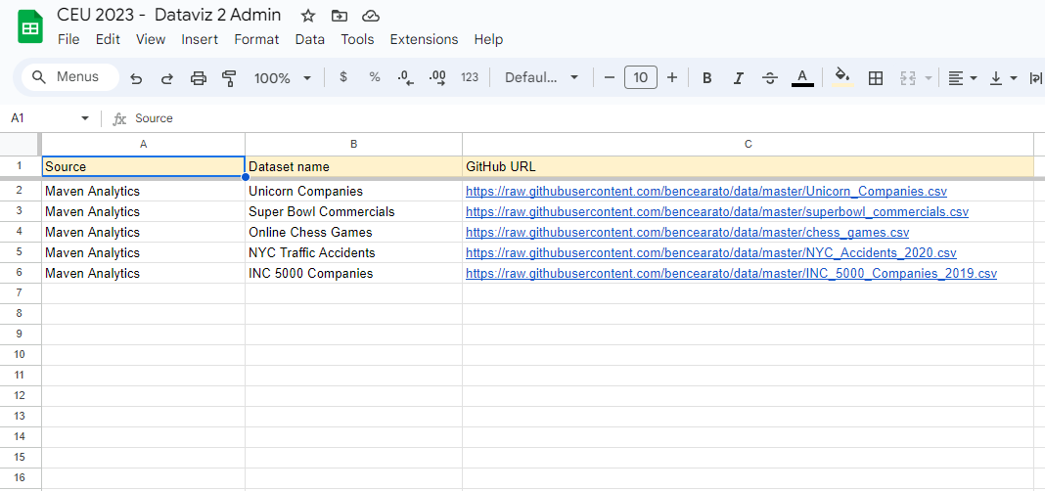
Using datasets from our repo
https://docs.google.com/spreadsheets/d/1AptJkoWuSfBixNhPiiS24JBFy9d99CvYxWpXpnpTf4w

Slide 8
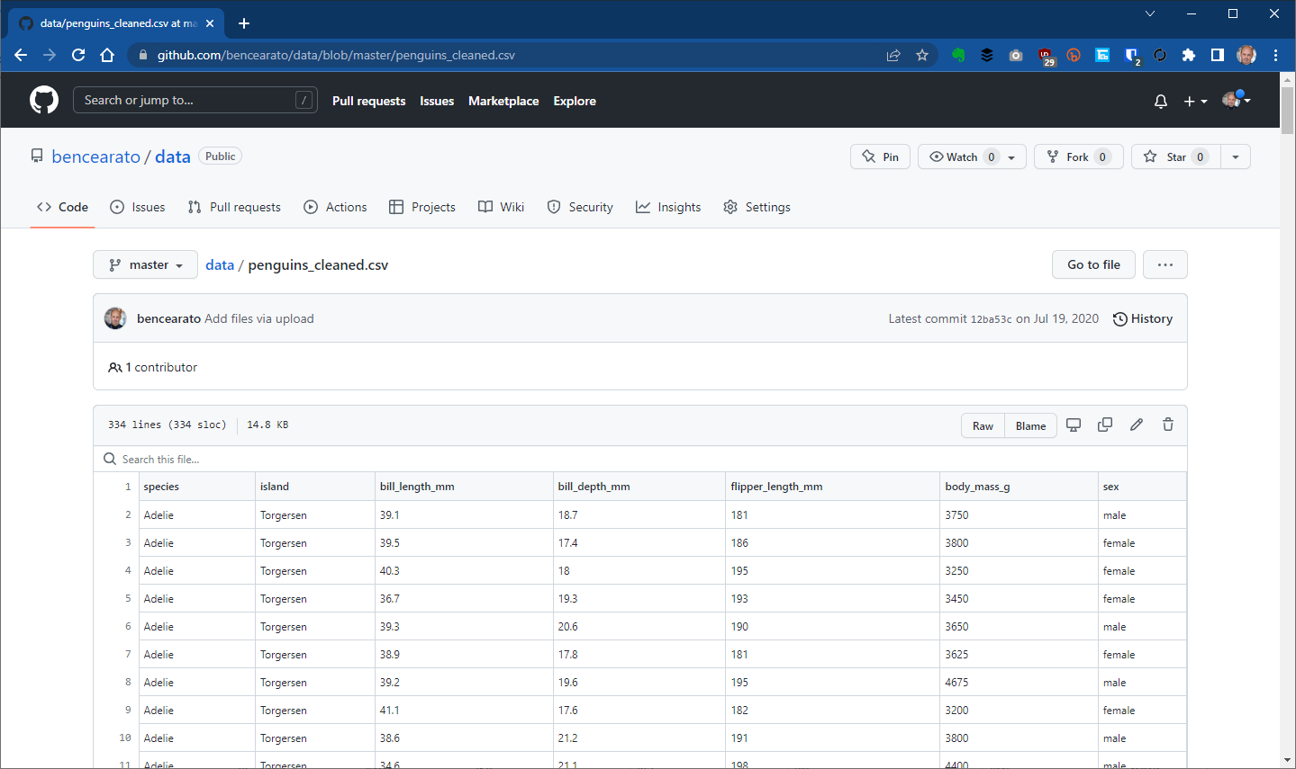
Using your own dataset and repo
Navigate to your dataset in your public Github repo and use the Raw button

Slide 9
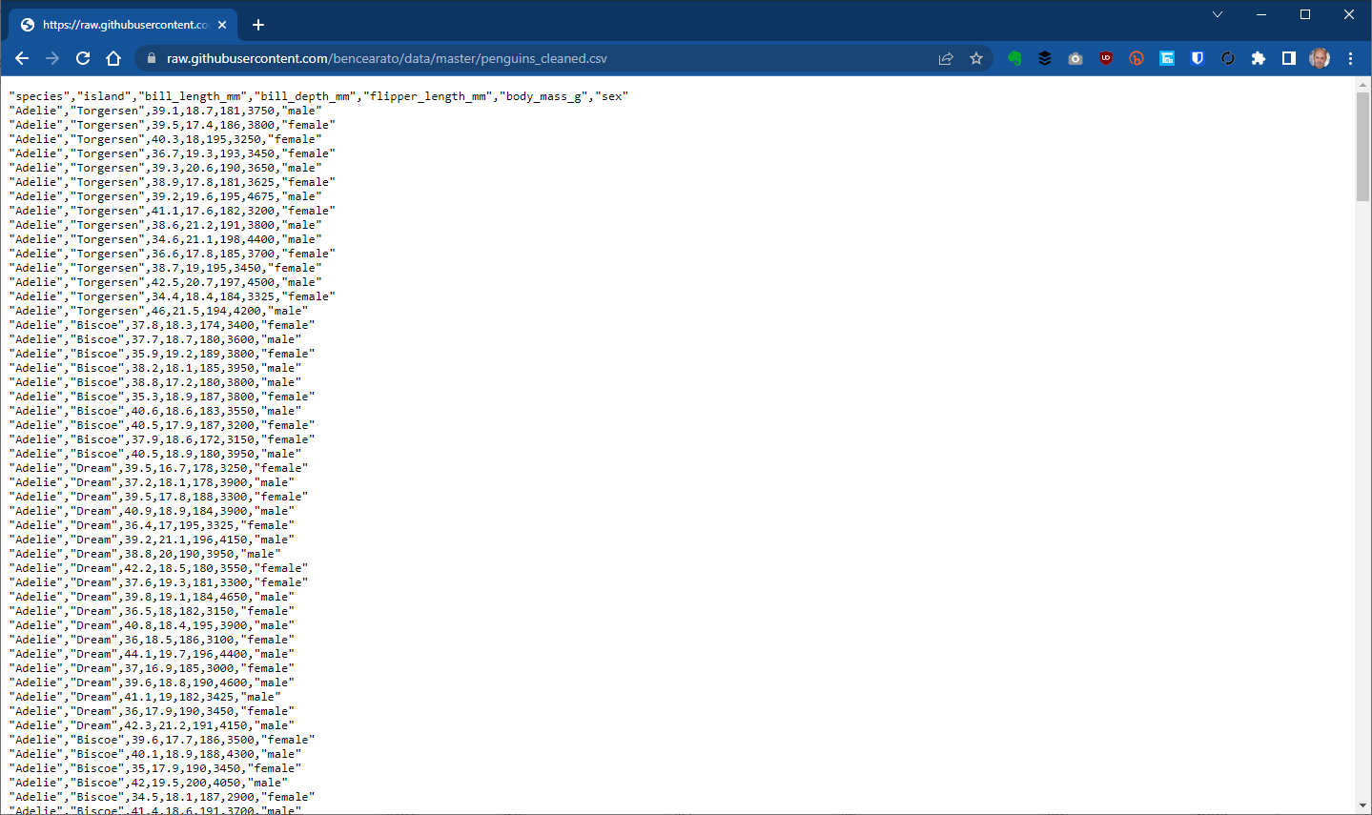
Using your own dataset and repo
Note the raw URL:
https://raw.githubusercontent.com/bencearato/data/master/penguins_cleaned.csv

Slide 10
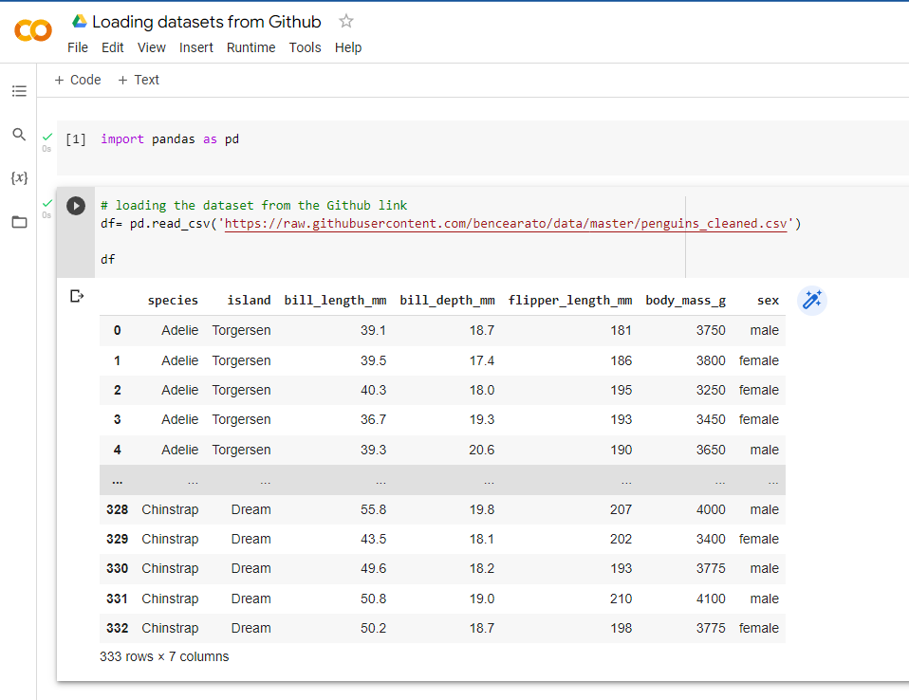
Load a Dataset from Github
Use to raw URL in the notebbok to access the dataset with the pd.read_csv Pandas function

Slide 11
Data Discovery
Create quick visualizations to understand the dataset
Column charts for each categorical variable to show list of values and row counts
Scatter plots are useful for relations between variables
Further options
There are also some dedicated Python packages for exploring the data (for example pandas-profiling or Lux), but they might be an overkill

Slide 12
Creating your notebook – the chart
Once you have a general concept create your first charts
The goal is to validate the concept
Focus only on the essential chart components
When you are satisfied with the draft chart, flash it out
Labels, formats, coloring, legend etc.
Add short inline comments to help to understand the code
# Creating a scatterplot to compare total_bill and tip
When the charts are final, document it!
Add Text Cells as necessary
Document your intent, what you wanted to do and why
You can also document your findings in business language, as you would describe it to the audience

Slide 13
Creating your notebook – the Dash App
When your chart are ready, create the Dash app
Single chart layout is OK
Add chart interactivity using dropdowns or radio buttons
You can also use a multichart layout (1+1 chart horizontally or vertically), but pay attention to the callback to update both!
Add descriptive texts (control label, chart titles etc) as needed
Document the app
Add a main Text cell at the beginning to describe how the app is designed to work
Use descriptive comments in the code cells to provide context and explanation

Slide 14
Submitting your work

Slide 15
Submission
The deadline is December 8 (Friday)
The Jupyter notebook file
Please review the notebook and remove unused empty cells
Mark sure all cells have at least some minimal comments. Don’t make us guess ☺
Use standard file names:
Your name – topic.ipynb (Bence Arato – HR Analytics.ipynb)
Use the Dropbox File Collector to submit the files
Enter the details in the Admin Google workbook

Slide 16
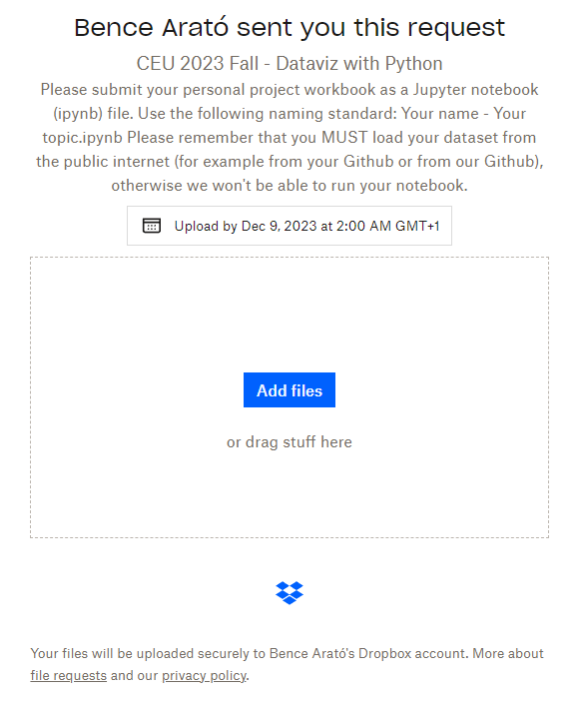
Submission – The Dropbox file collector
https://www.dropbox.com/request/Gu7L71UybY71o0JD1B8v

Slide 17
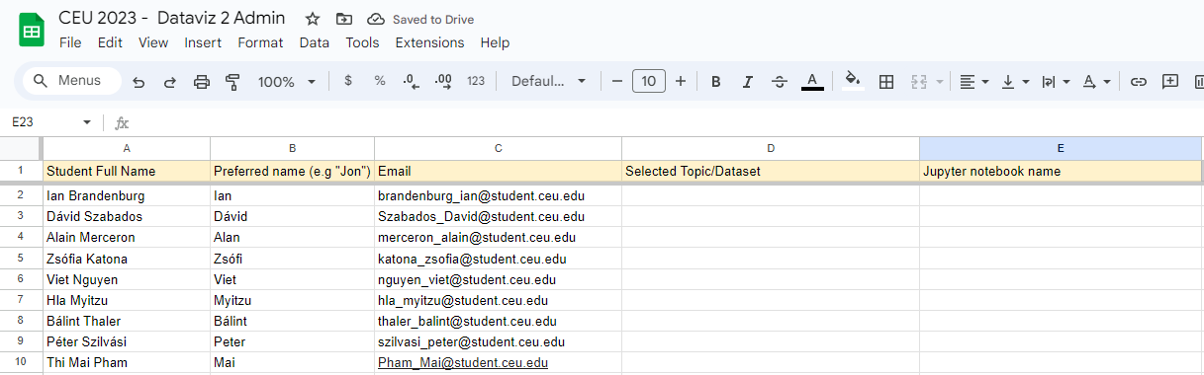
Submission – The admin worksheet
https://docs.google.com/spreadsheets/d/1AptJkoWuSfBixNhPiiS24JBFy9d99CvYxWpXpnpTf4w

Slide 18
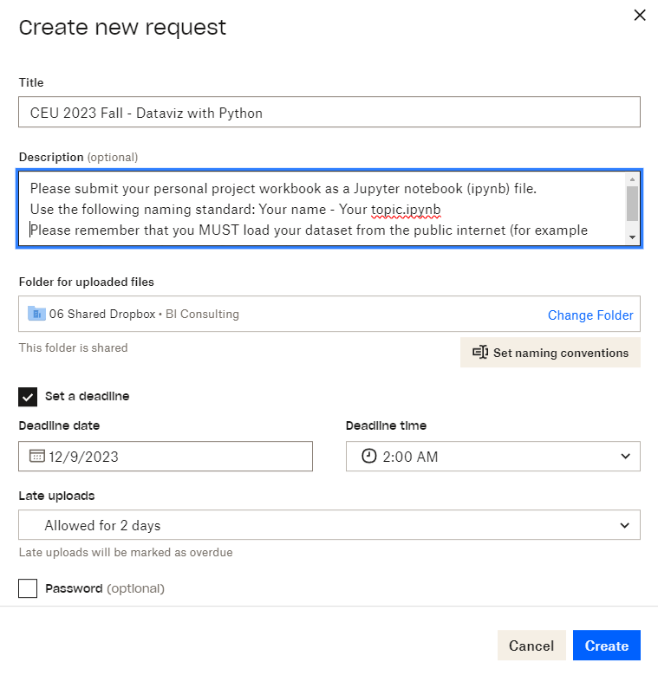
Submission setup
Notes:
https://www.dropbox.com/request/Gu7L71UybY71o0JD1B8v
CEU 2023 Fall - Dataviz with Python
Please submit your personal project workbook as a Jupyter notebook (ipynb) file.
Use the following naming standard: Your name - Your topic.ipynb
Please remember that you MUST load your dataset from the public internet (for example from your Github or from our Github), otherwise we won't be able to run your notebook.
Official deadline is December 8, Friday.
Dropbox deadline is set to December 9, 2am.
Late uploads allowed for 2 more days.

Slide 19
Thank You

